Slide 1
Prezentare 1 Calcul Mobil
DnD Character Creator
Safciu Alexandru Radu

Slide 2
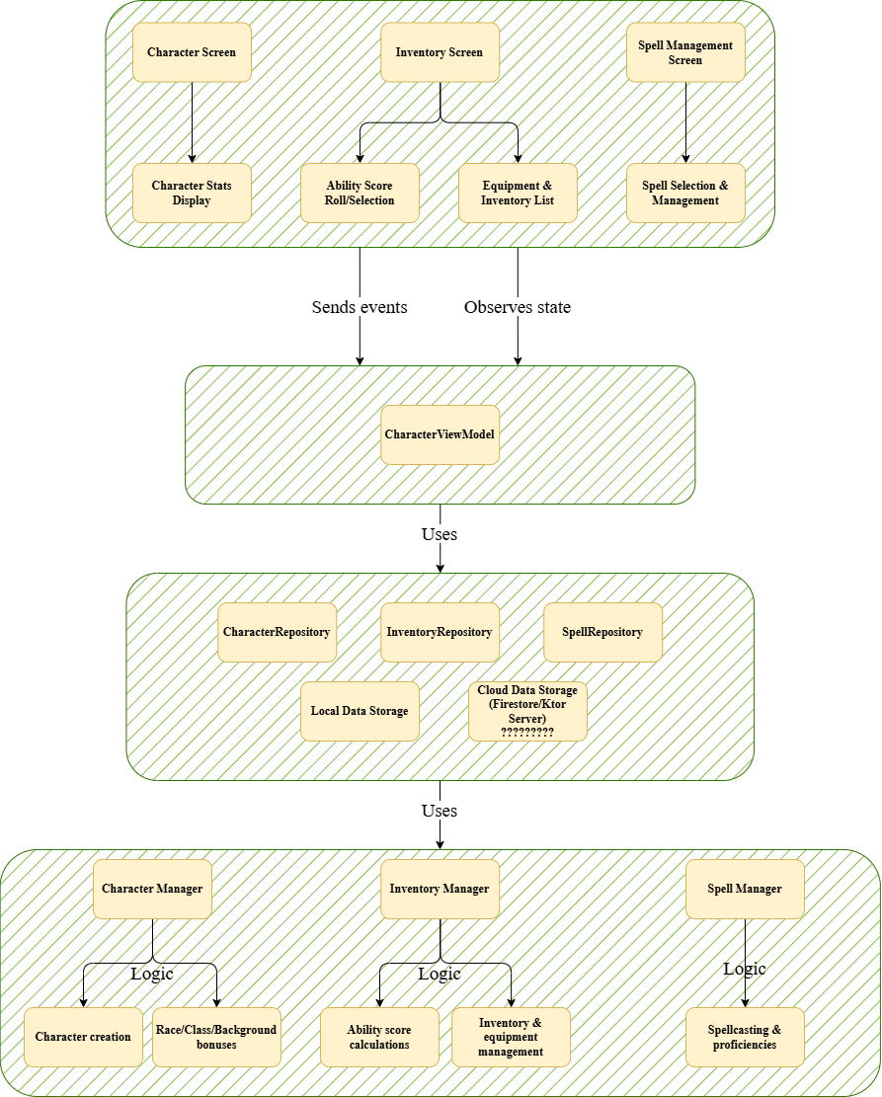
Arhitectura aplicatiei
1. Frontend (Android-Specific UI)
Jetpack Compose for UI components
Screens:
Character Screen
Inventory Screen
Spell Management Screen
Components:
Character Stats Display
Ability Score Roll/Selection
Equipment & Inventory List
Spell Selection & Management
2. ViewModel Layer
CharacterViewModel (Handles character state & updates)
Sends events to business logic
Observes state for UI updates
3. Shared Business Logic (Kotlin Multiplatform - KMP)
Handles core logic for:
Character creation
Race/Class/Background bonuses
Ability score calculations
Inventory & equipment management
Spellcasting & proficiencies
Uses repositories for data management
4. Data Layer (Persistence & Cloud Sync)
Repositories:
CharacterRepository
InventoryRepository
SpellRepository
Uses:
SQLDelight (Local SQLite database for character storage)
Ktor (optional) (For cloud save functionality)
5. Cloud Save (Optional - Character Backup & Sync)
Firebase (Firestore/Realtime Database for cloud-based character backups)
Ktor Server (Optional) (Custom backend for cloud storage and sync)

Slide 3
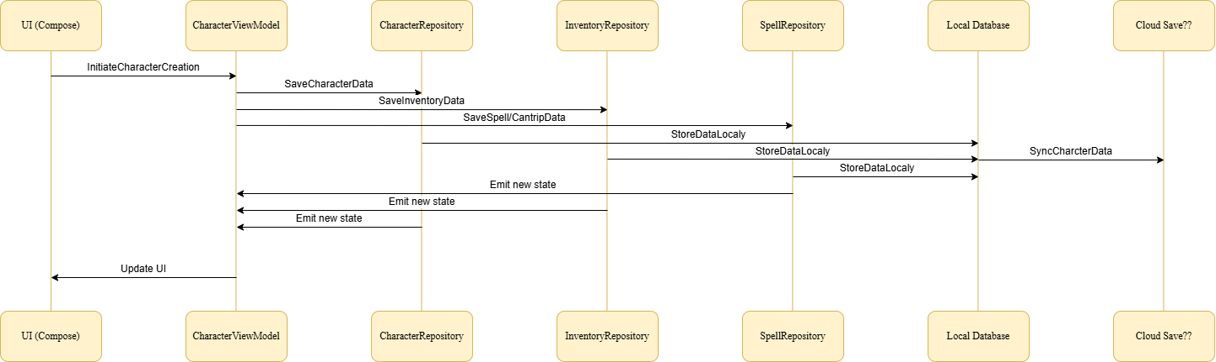
Use Case pentru crearea unui caracter

Slide 4
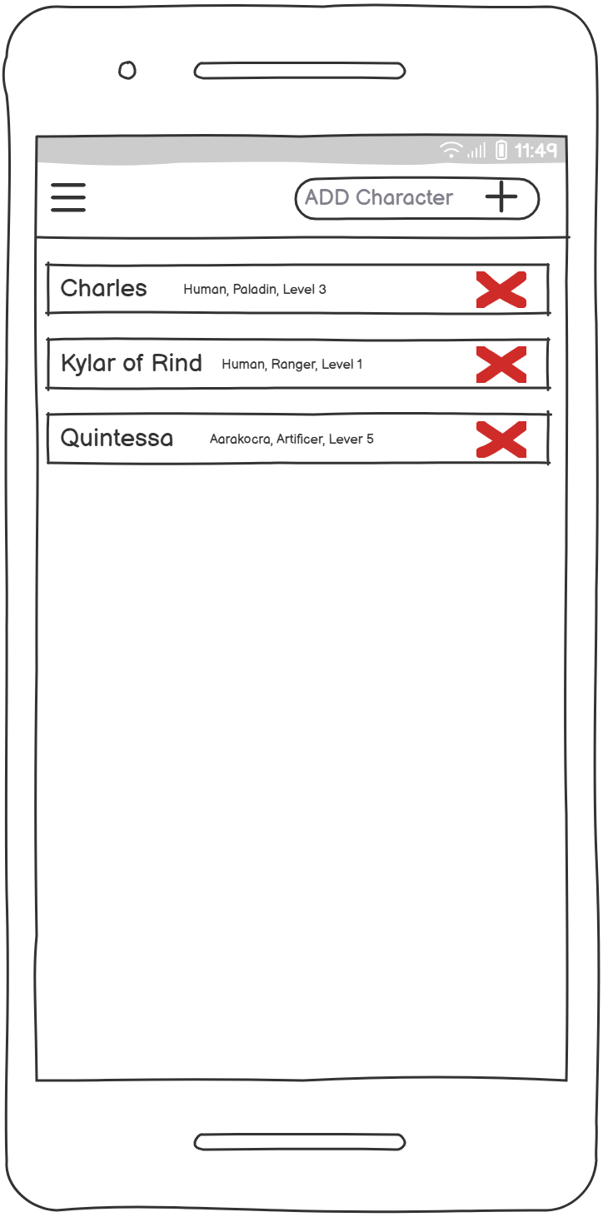
Mock-up-uri
Home page

Slide 5
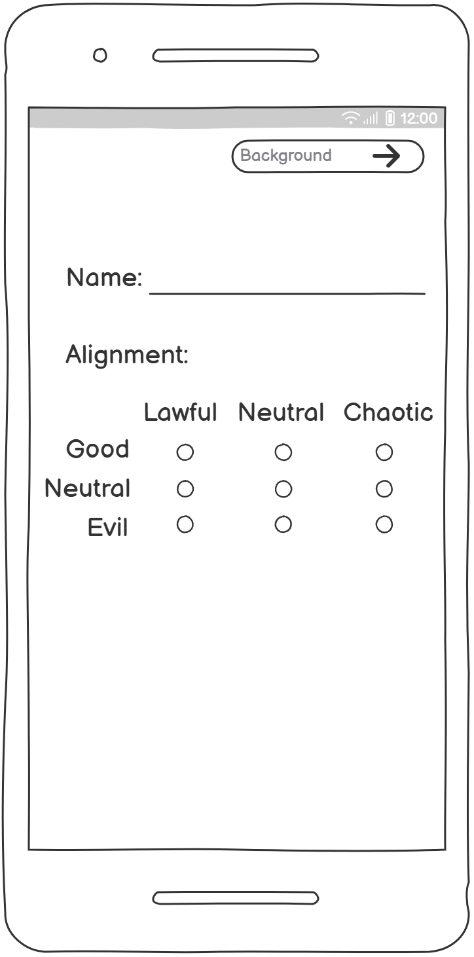
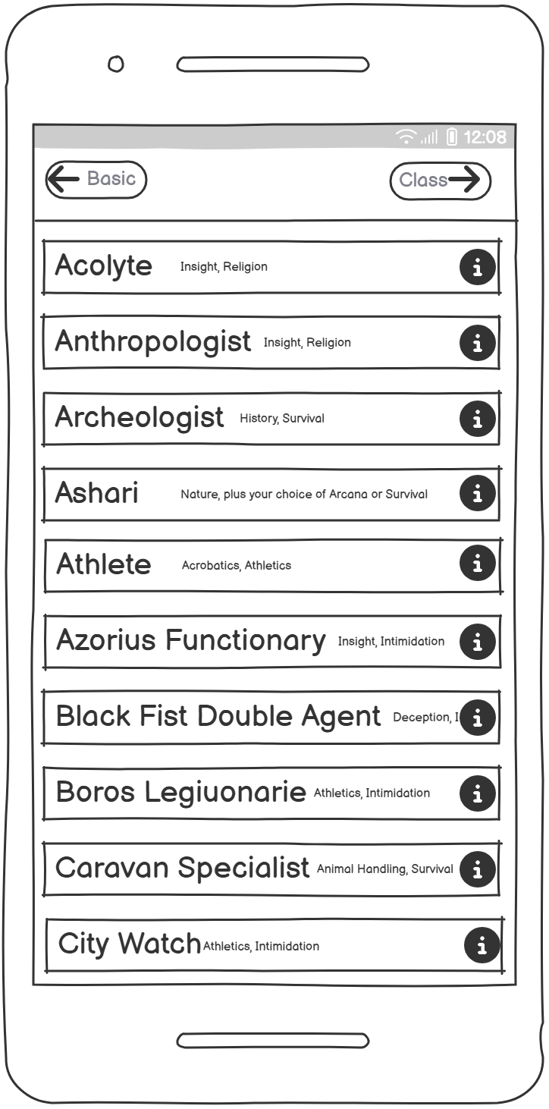
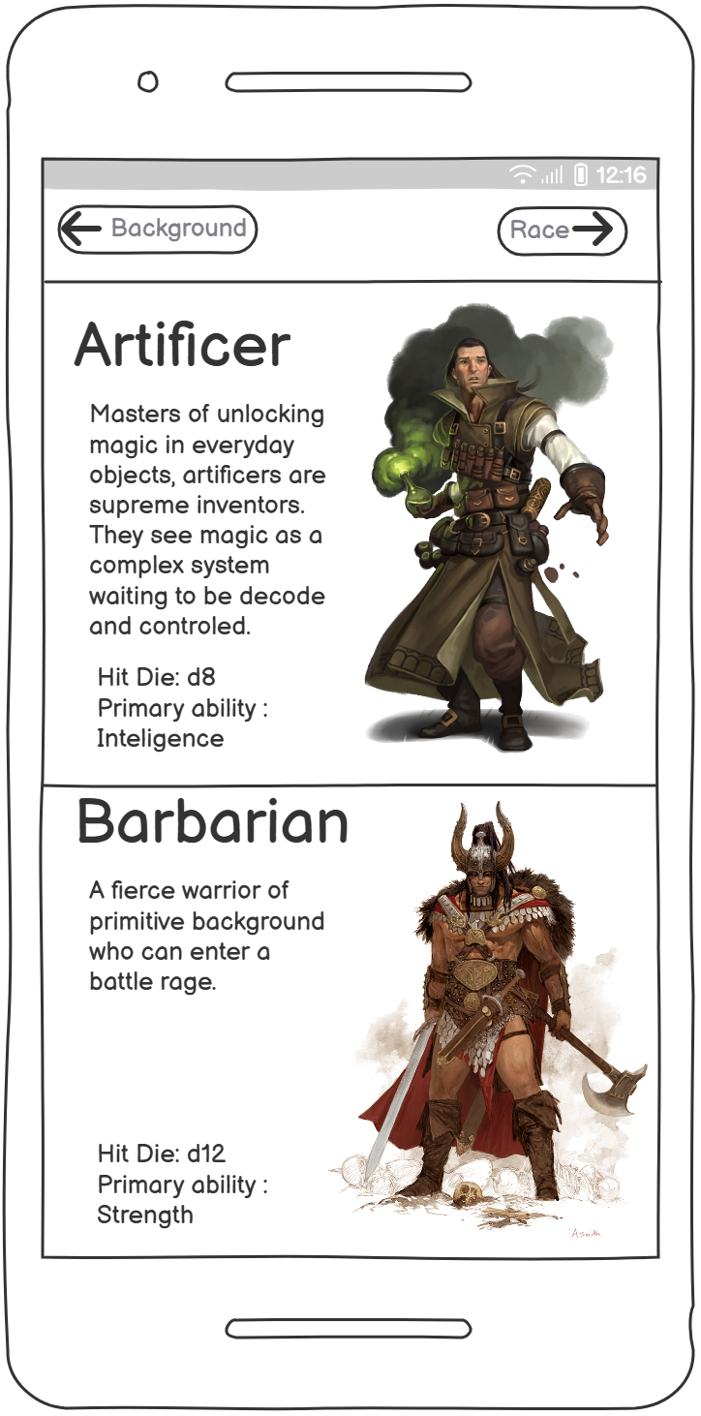
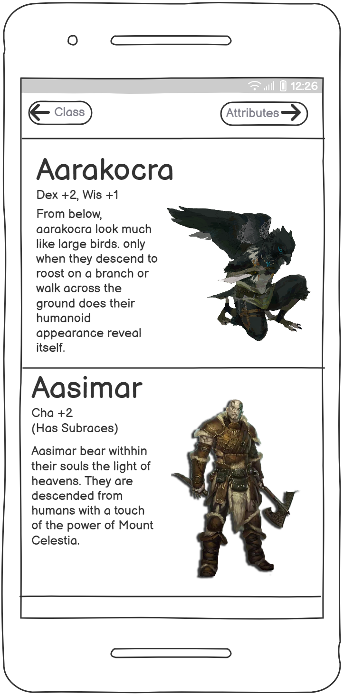
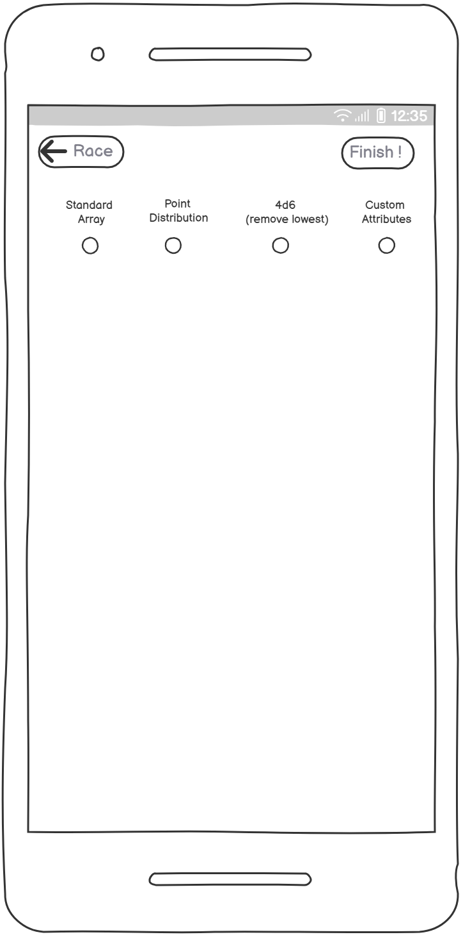
Mock-up-uri
Character creation screens

Slide 6
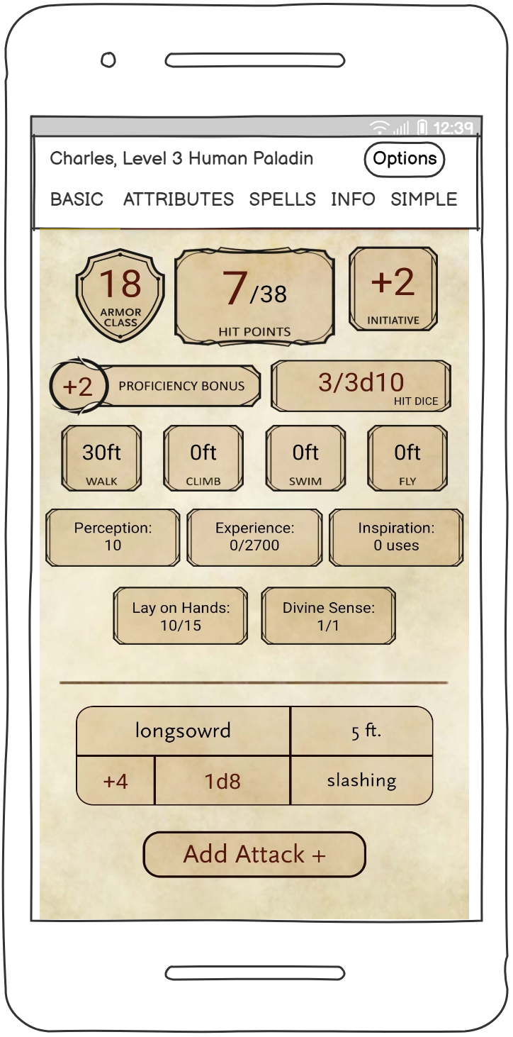
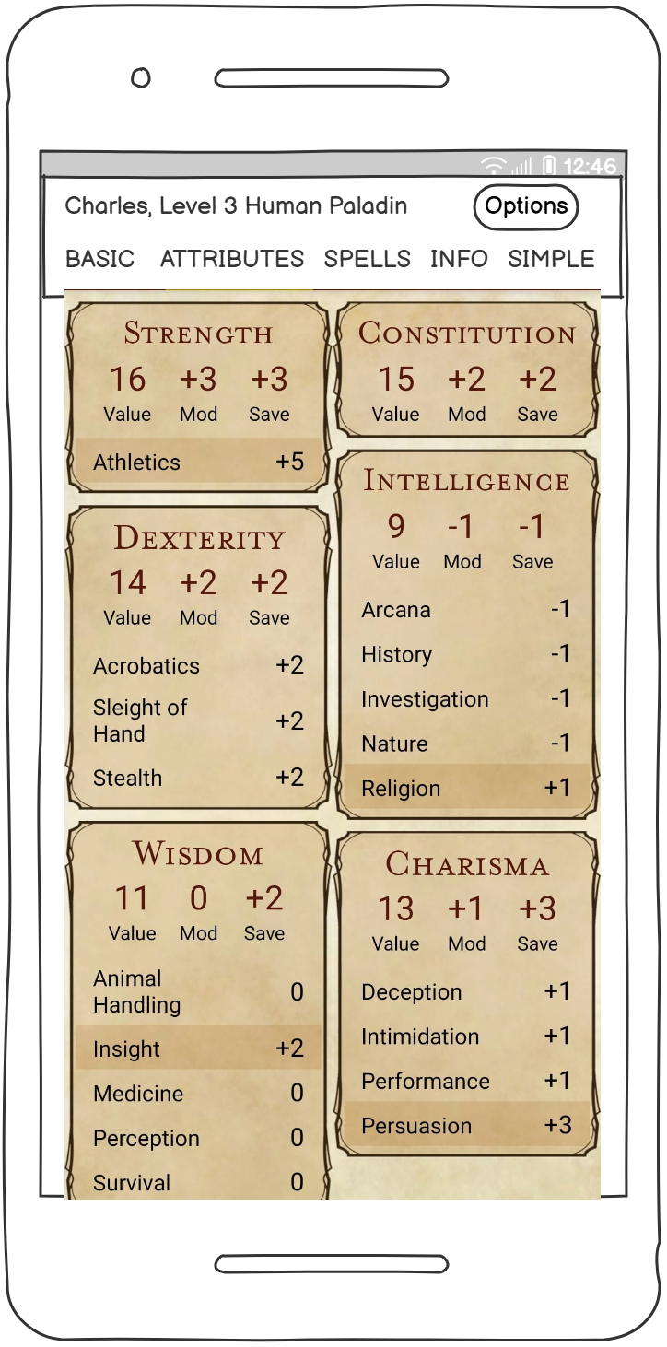
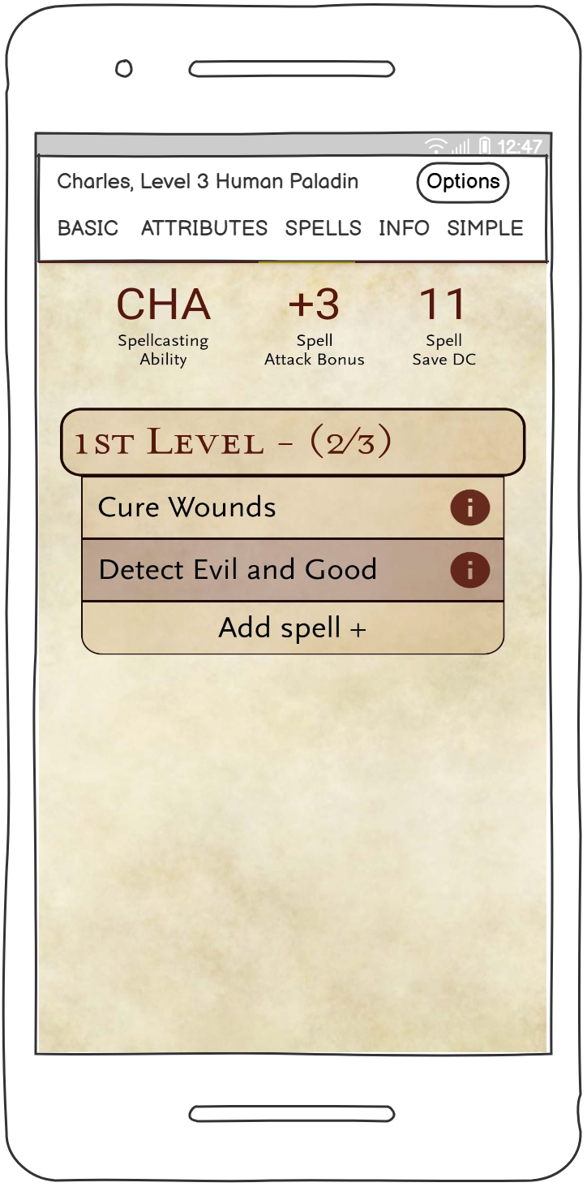
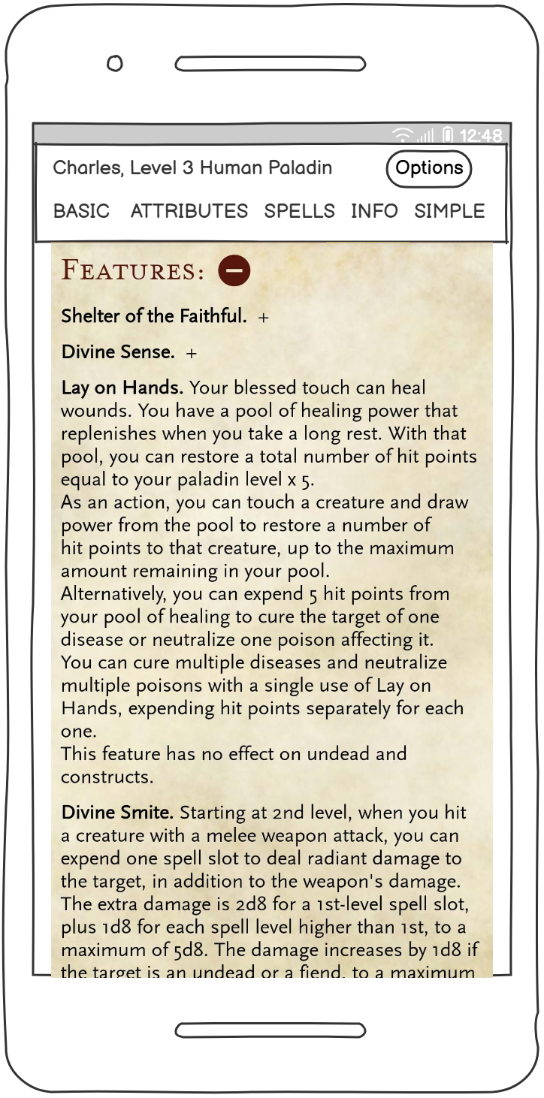
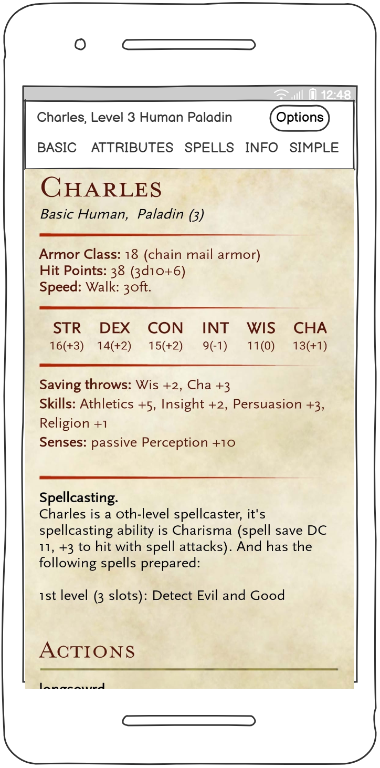
Mock-up-uri
Character Menus

